Slide 1




Kalman-and-Bayesian-Filters-in-Python
Preface
Mar 12th, 2022 https://github.com/duyongquan/LTSLAM
AibotBeginer 视觉SLAM
quandy2020@126.com

Slide 2
2
Outline
Kalman and Bayesian Filters
Motivation for this Book
Reading Online
PDF Version
Downloading and Running the Book
Jupyter
SciPy, NumPy, and Matplotlib

Slide 3
Kalman and Bayesian Filters
3
卡尔曼和贝叶斯滤波

Slide 4
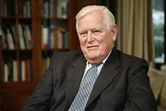
4
Kalman and Bayesian Filters
Sensors are noisy
GPS in my car reports altitude, Each time pass the same point, it reports a slightly different altitude
Kitchen scale gives different readings weigh the same object twice.
Sensor is very noisy, environment makes data collection difficult. How can track?
Rudolf Emil Kálmán
鲁道夫·卡尔曼 匈牙利裔美国数学家
Introduction
Apollo missions to the moon
Aaircraft, submarines, cruise missiles
Medical imaging
Robots, IoT (Internet of Things) , laboratory instruments

Slide 5
Motivation for this Book
5
书的目标

Slide 6
6
Motivation for this Book
The theory is beautiful, but quite difficult to learn
signal processing
control theory
probability and statistics
Ohter books quite difficult to learn
notation is introduced without explanation
books are almost devoid of examples or worked problems
no idea as to what real world phenomena these words and math were attempting to describe

Slide 7
Reading Online
7
在线阅读

Slide 8
8
Reading Online
GitHub
https://github.com/rlabbe/Kalman-and-Bayesian-Filters-in-Python
ninder
binder serves interactive notebooks online
http://mybinder.org/repo/rlabbe/Kalman-and-Bayesian-Filters-in-Python
nbviewe
https://nbviewer.org/github/rlabbe/Kalman-and-Bayesian-Filters-in-Python/tree/master/

Slide 9
PDF Version
9
PDF 版本

Slide 10
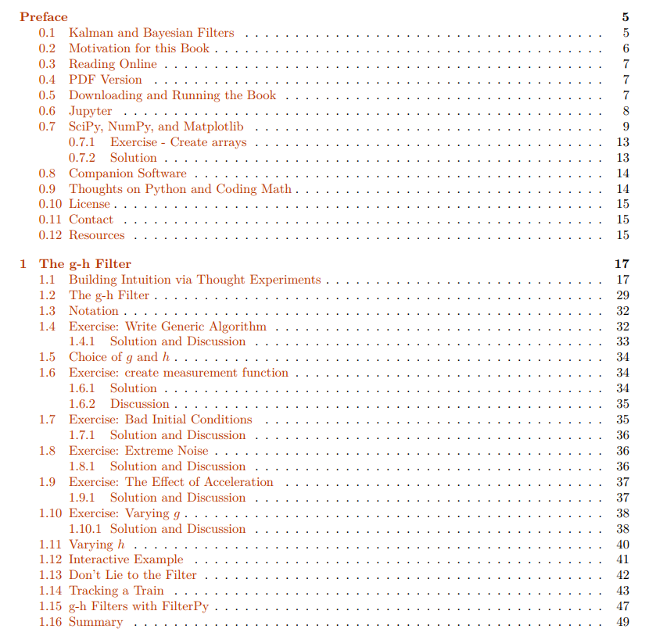
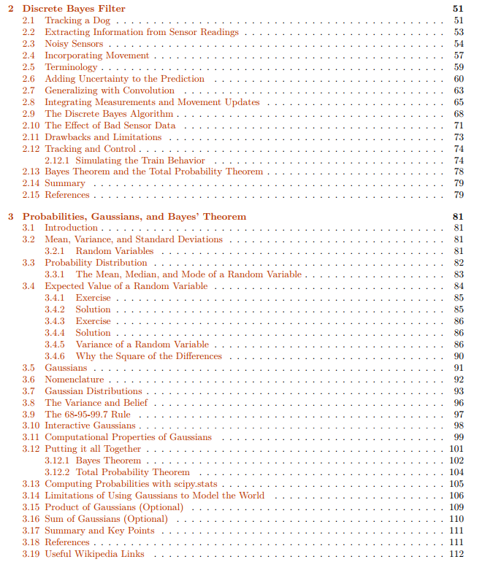
10
PDF Version
PDF book
https://drive.google.com/file/d/0By_SW19c1BfhSVFzNHc0SjduNzg/view?resourcekey=0-41olC9ht9xE3wQe2zHZ45A

Slide 11
Downloading and Running
the Book
11
下载和运行

Slide 12
12
Downloading and Running the Book
Installation
http://nbviewer.ipython.org/github/rlabbe/Kalman-and-Bayesian-Filters-in-Python/blob/master/Appendix-A-Installation.ipynb
Introduce
This book is intended to be interactive and I recommend using it.
Its a little more effort to set up.
You can perform experiments, see how filters react to different data, see how different filters react to the same data, and so on

Slide 13
Jupyter
13
开发环境

Slide 14
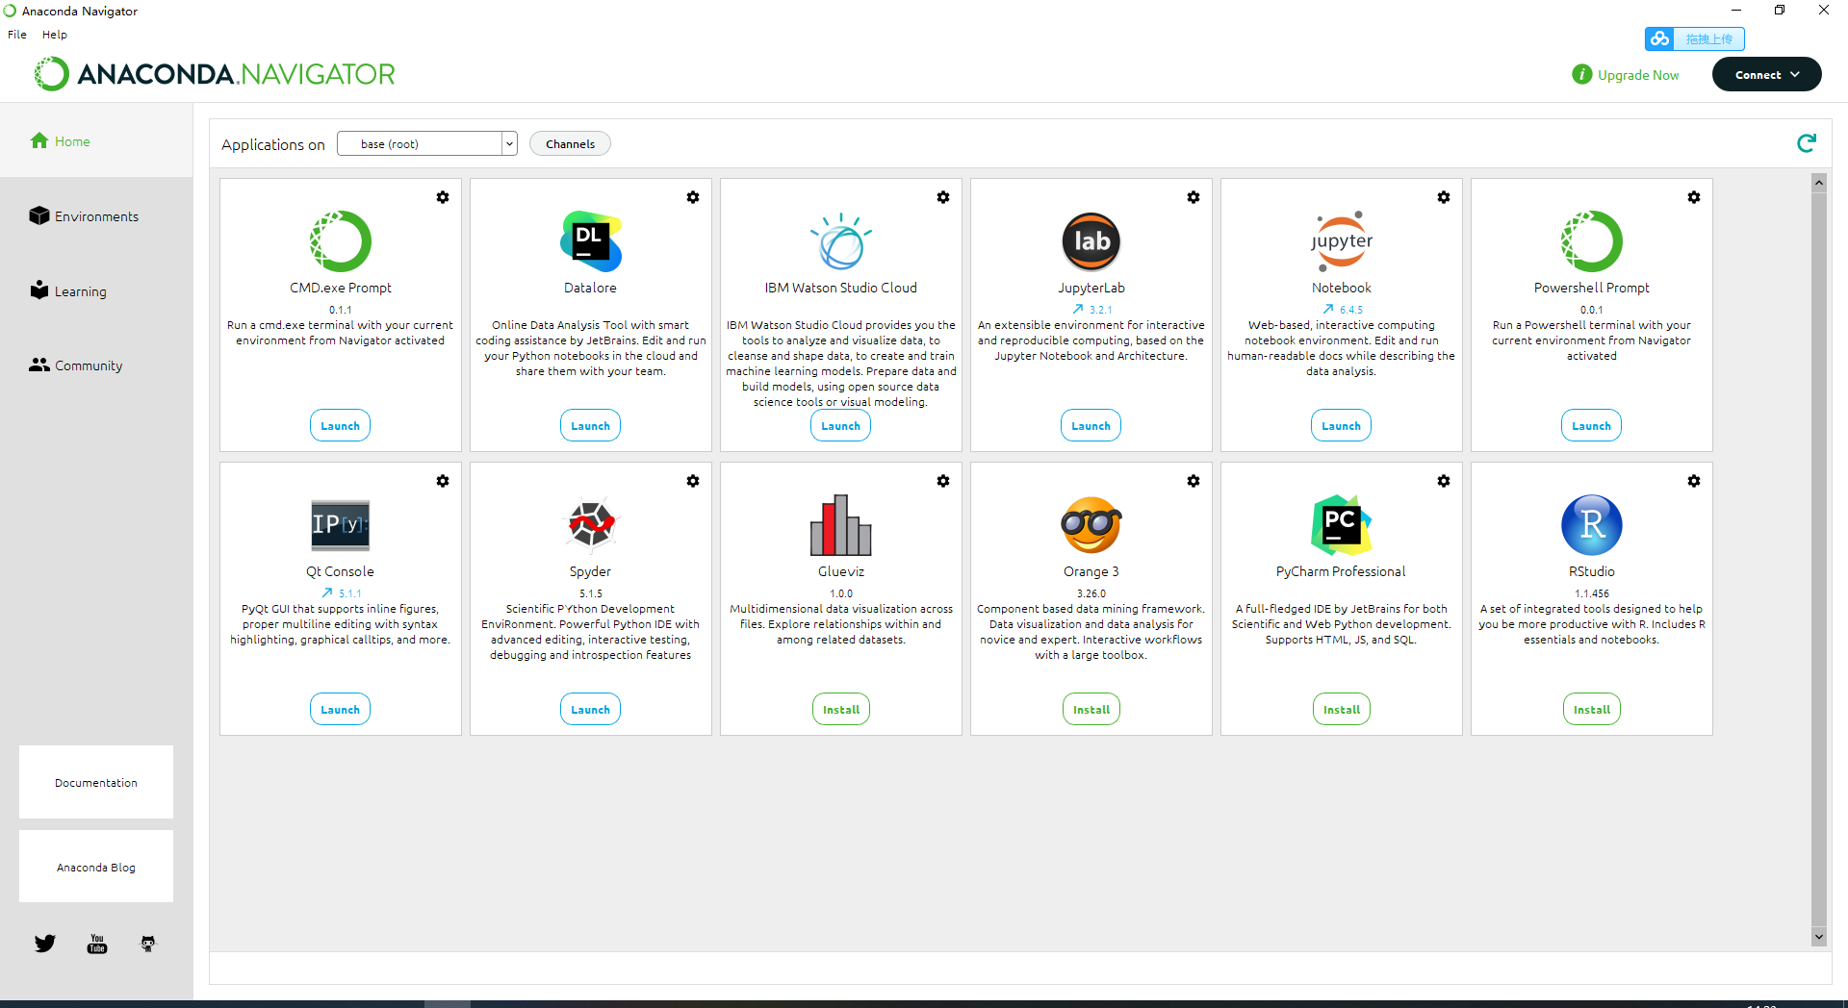
14
Jupyter
jupyter notebook
安装Anaconda

Slide 15
SciPy, NumPy, and Matplotlib
15
Python 库

Slide 16
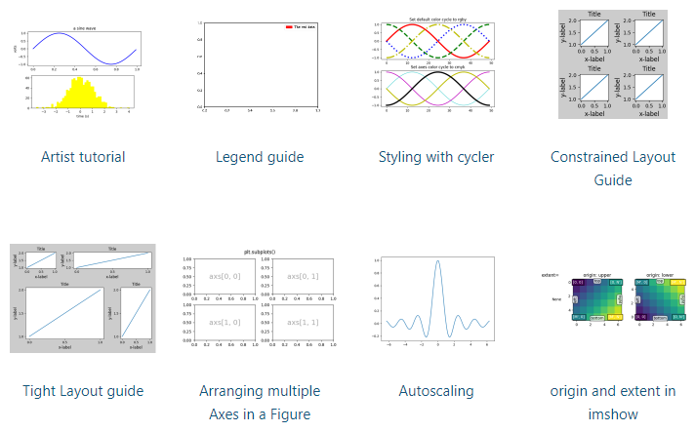
16
SciPy, NumPy, and Matplotlib
SciPy is a mathematic
array objects
https://scipy.org/
linear algebra
random numbers
NumPy
Matplotlib
https://matplotlib.org/stable/tutorials/index

Slide 17
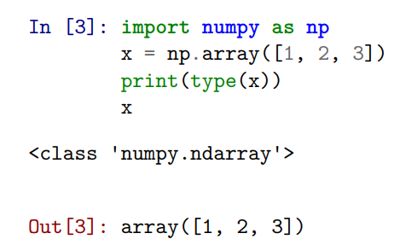
17
SciPy, NumPy, and Matplotlib
numpy.array implements a one or more dimensional array

Slide 18
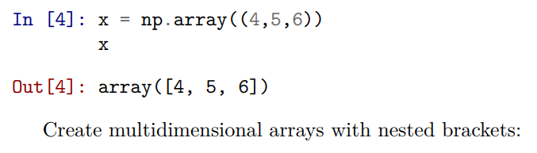
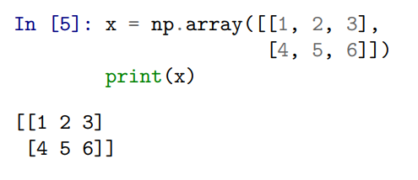
18
SciPy, NumPy, and Matplotlib
numpy.array implements a one or more dimensional array

Slide 19
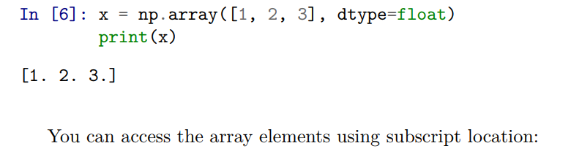
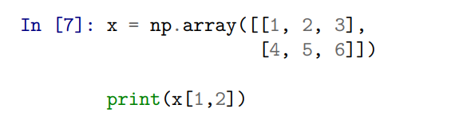
19
SciPy, NumPy, and Matplotlib
numpy.array implements a one or more dimensional array

Slide 20
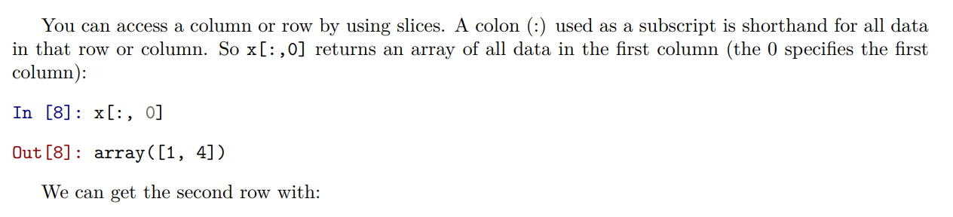
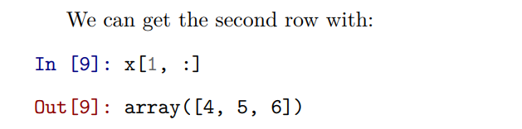
20
SciPy, NumPy, and Matplotlib
numpy.array implements a one or more dimensional array

Slide 21
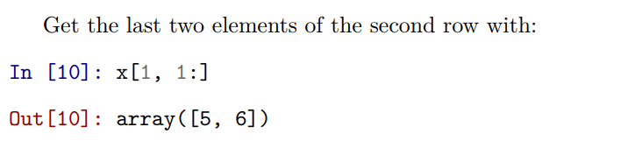
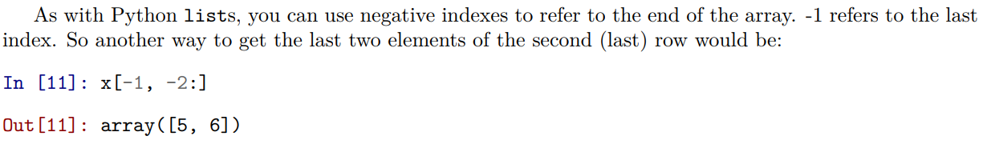
21
SciPy, NumPy, and Matplotlib

Slide 22
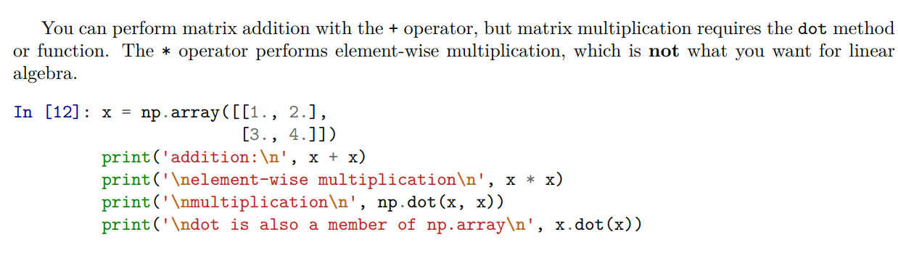
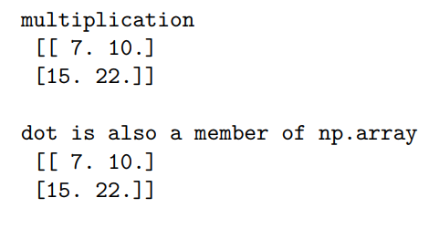
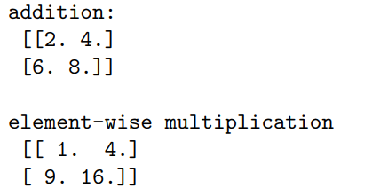
22
SciPy, NumPy, and Matplotlib

Slide 23
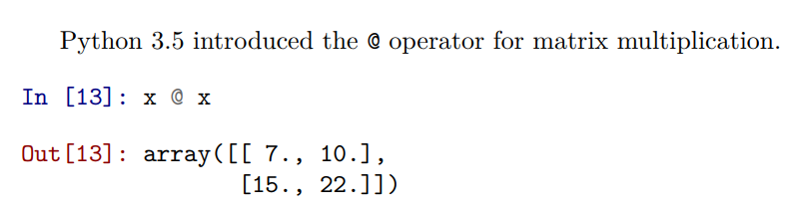
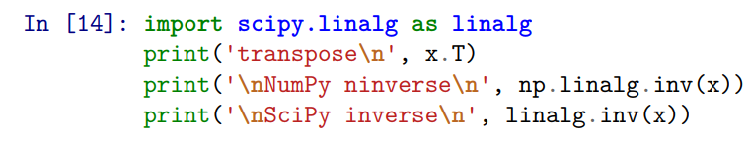
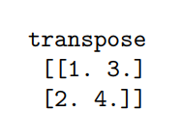
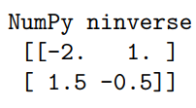
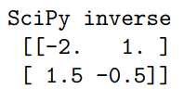
23
SciPy, NumPy, and Matplotlib
transpose and the inverse

Slide 24
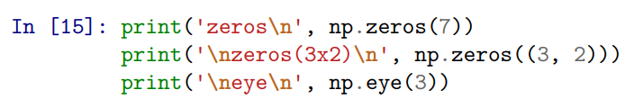
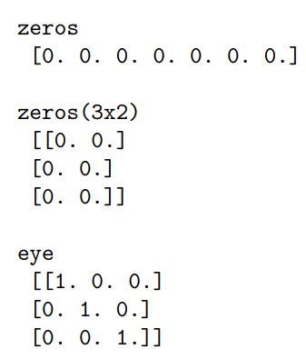
24
SciPy, NumPy, and Matplotlib
zeros matrix , ones matrix, eye identity matrix

Slide 25
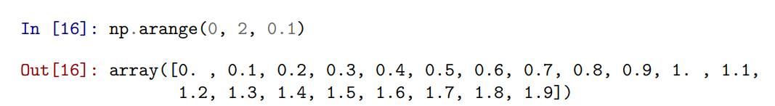
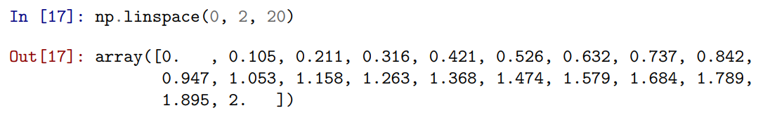
25
SciPy, NumPy, and Matplotlib

Slide 26
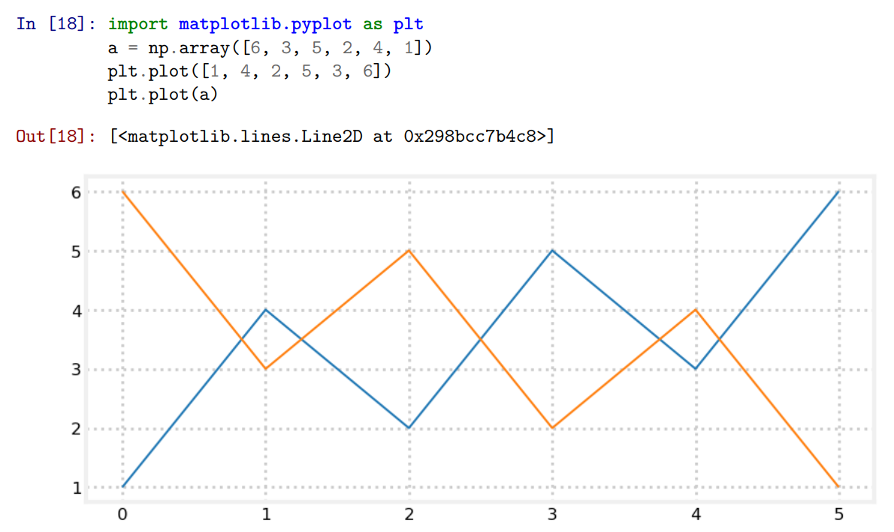
26
SciPy, NumPy, and Matplotlib

Slide 27


